Slide 1

Metagenomics: From Bench to Data Analysis
12-16th October 2015
Introduction to tools and approaches for analysing and interpreting metagenomic datasets
Mark Alston, PhD
Computational Biologist
Regulatory & Environmental Genomics Group
mark.alston@tgac.ac.uk
Notes:
Introduce myself!!

Slide 2

Outline
Basic analytical workflow
How best to implement that workflow
Closer look at some key steps – decisions, decisions…
Highlight good, useful software throughout
Meta*omics at TGAC
Notes:
Is there an ‘easy’ option???

Slide 3
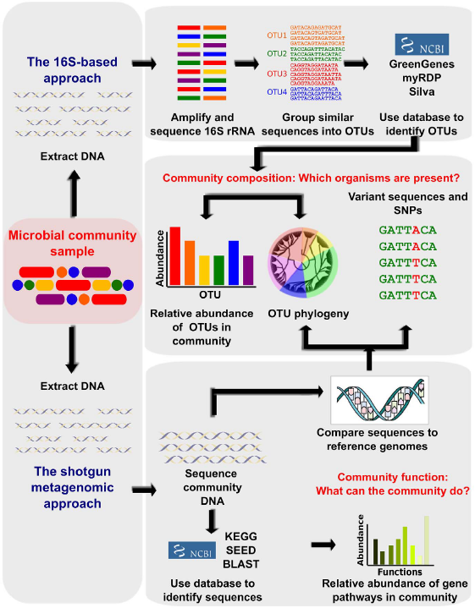
Metagenomics in a Nutshell
Broad overview of bioinformatic methods for functional metagenomics
Morgan XC, Huttenhower C (2012)
PLoS Comput Biol 8(12): e1002808.

Slide 4
A Basic workflow
Quality control and quality trimming of reads
Binning [classification]
Community profiling
Analyse and compare samples
Notes:
Is there an ‘easy’ option???

Slide 5

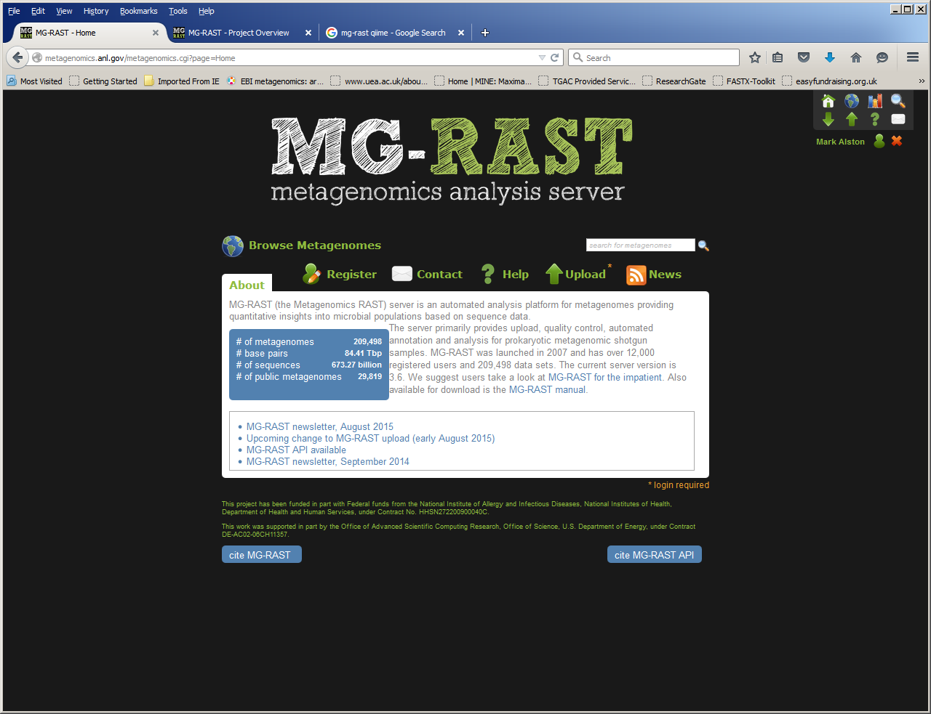
Meta*omics for the Nervous: Web-servers
http://metagenomics.anl.gov/metagenomics.cgi?page=Home
Registration required and optimised for Firefox
Can export results to other software

Slide 6
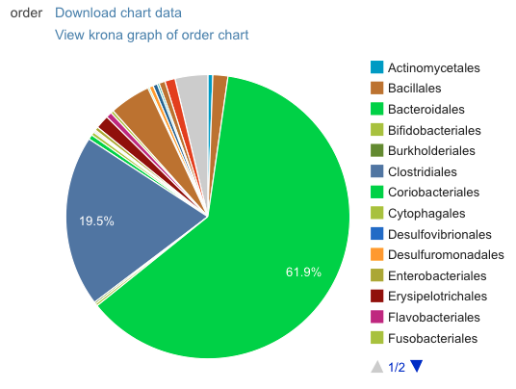
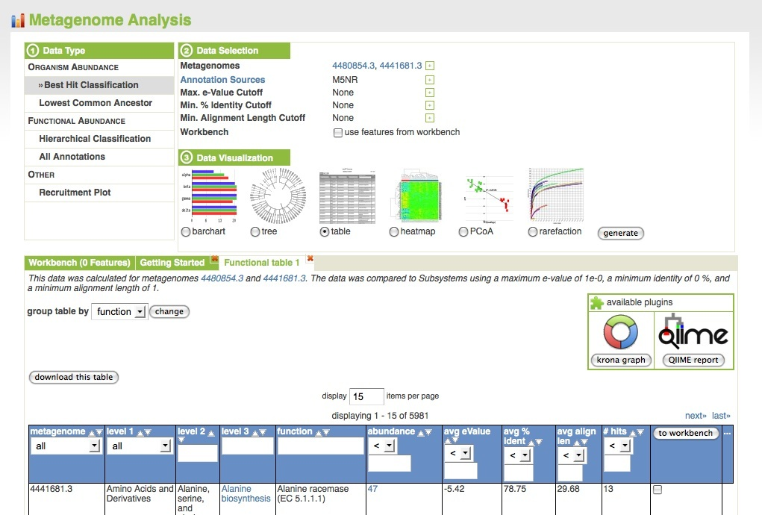
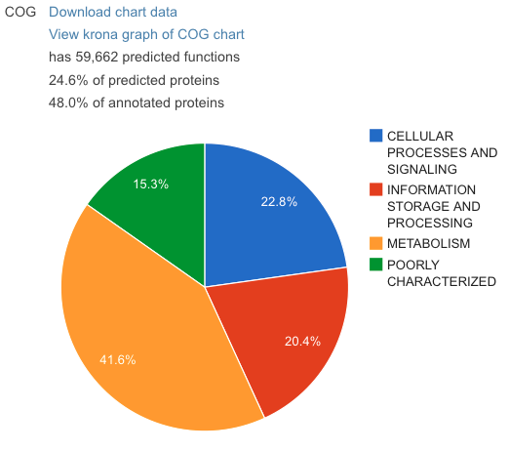
Meta*omics for the Nervous: Web-servers
http://metagenomics.anl.gov/metagenomics.cgi?page=Home
Sample inspection & data analysis

Slide 7

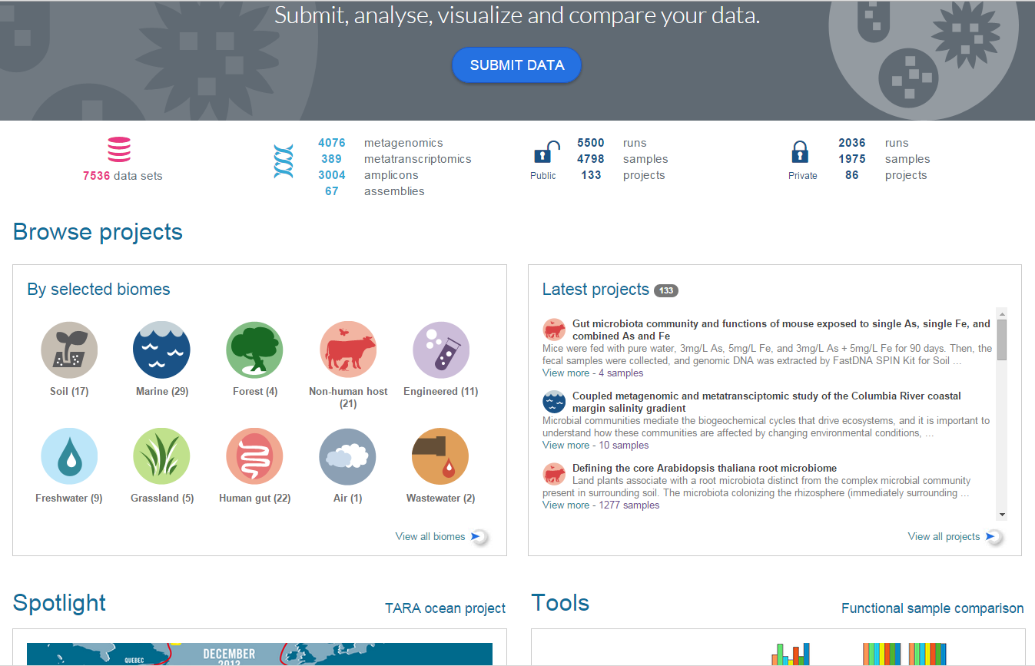
Meta*omics for the Nervous: Web-servers
https://www.ebi.ac.uk/metagenomics/

Slide 8
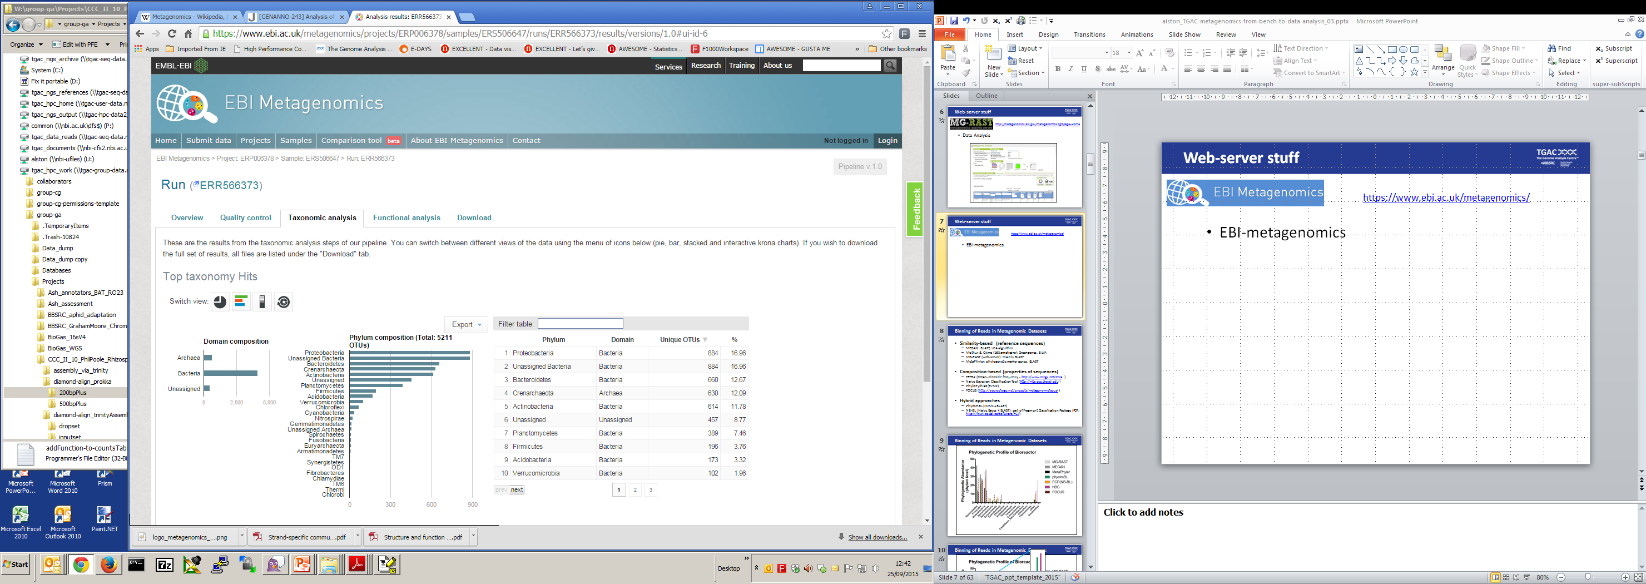
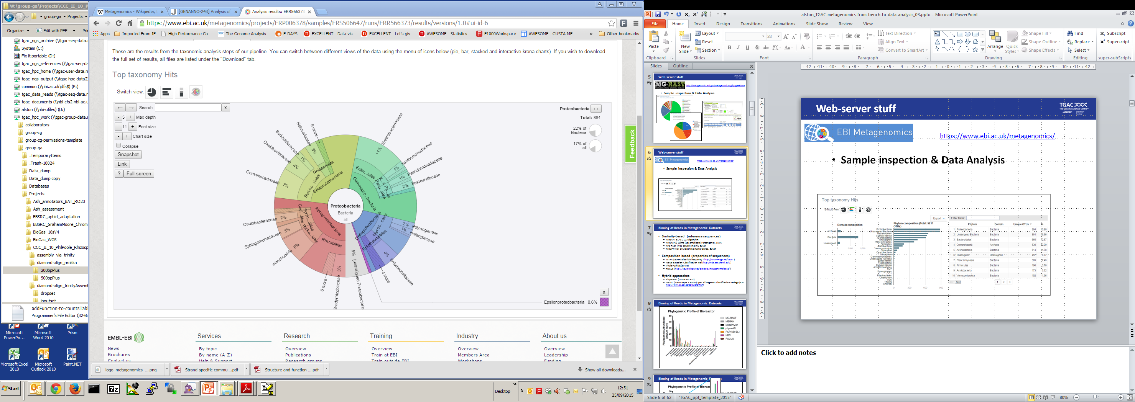
Meta*omics for the Nervous: Web-servers
https://www.ebi.ac.uk/metagenomics/
Sample inspection & data analysis

Slide 9
Meta*omics for the Nervous: Web-servers
https://www.ebi.ac.uk/metagenomics/
Sample inspection & data analysis
Krona ‘zoomable pie charts’
Interactive, via browser window
Great for sharing with collaborators
https://github.com/marbl/Krona/wiki

Slide 10
A Basic workflow
Quality control and quality trimming of reads
Binning [classification]
Community profiling
Analyse and compare samples

Slide 11
A Basic workflow
Quality control and quality trimming of reads
Binning [classification]
Community profiling
Analyse and compare samples
But:
Uploading big data sets is problematic
Constrained by the tools supplied

Slide 12
A Basic workflow
Quality control and quality trimming of reads
Binning [classification]
Community profiling
Analyse and compare samples
Can use a webserver, but for ultimate flexibility over the analysis, work at the command line
Notes:
Is there an ‘easy’ option???

Slide 13
The Command Line [gulp]
File manipulation [e.g. fix headers across many files]
Can record what you did [and repeat it, exactly]
Less tedious and less error-prone
Run commands on compute clusters
Others?
http://ivory.idyll.org/blog/2013-sesync-meeting.html

Slide 14
A Basic workflow: YOU decide
Quality control and quality trimming of reads [cutadapt, FASTQC]
http://www.bioinformatics.babraham.ac.uk/projects/trim_galore/
Assembly of reads
IDBA-UD, meta-velvet etc.
Binning [classification]
Similarity-based
Composition-based
Community profiling
Counts of OTUs/taxa/functions
Contingency tables
Analyse and compare samples
Relative abundance, heatmaps, ordination, statistical significance
Notes:
YOU can decide how to QC the data, or assemble the reads etc, or which comparisons you want to make
My focus will be on analysis, and contingency tables are the leaping off point for us here

Slide 15
A Basic workflow: YOU decide
Quality control and quality trimming of reads [cutadapt, FASTQC]
http://www.bioinformatics.babraham.ac.uk/projects/trim_galore/
Assembly of reads
Binning [classification]
Similarity-based
Composition-based
Community profiling
Counts of OTUs/taxa/functions
Contingency tables
Analyse and compare samples
Relative abundance, heatmaps, ordination, statistical significance
Notes:
My focus will be on analysis, and binnning/contingency tables are the leaping off point for us here

Slide 16
Binning [classification] of Reads in Metagenomic Datasets
Similarity-based (reference sequences)
MEGAN: BLAST [Diamond, RapSearch2], LCA algorithm
Mothur & Qiime (16S amplicons): Greengenes, SILVA
MG-RAST (web-server): mainly BLAST
MetaPhyler: phylogenetic marker genes, BLAST
Notes:
What could be simpler?!

Slide 17
Binning [classification] of Reads in Metagenomic Datasets
Similarity-based (reference sequences)
MEGAN: BLAST [Diamond, RapSearch2], LCA algorithm
Mothur & Qiime (16S amplicons): Greengenes, SILVA
MG-RAST (web-server): mainly BLAST
MetaPhyler: phylogenetic marker genes, BLAST
Composition-based (properties of sequences)
TETRA (tetranucleotide frequency - http://www.megx.net/tetra )
Naïve Bayesian Classification Tool (http://nbc.ece.drexel.edu )
PhyloPythiaS (SVMs)
FOCUS (http://sourceforge.net/projects/metagenomefocus/ )
Notes:
Composition-based would seem useful for microbes NOT in the database

Slide 18
Binning [classification] of Reads in Metagenomic Datasets
Similarity-based (reference sequences)
MEGAN: BLAST [Diamond, RapSearch2], LCA algorithm
Mothur & Qiime (16S amplicons): Greengenes, SILVA
MG-RAST (web-server): mainly BLAST
MetaPhyler: phylogenetic marker genes, BLAST
Composition-based (properties of sequences)
TETRA (tetranucleotide frequency - http://www.megx.net/tetra )
Naïve Bayesian Classification Tool (http://nbc.ece.drexel.edu )
PhyloPythiaS (SVMs)
FOCUS (http://sourceforge.net/projects/metagenomefocus/ )
Hybrid approaches
PhymmBL (IMMs + BLAST - https://ccb.jhu.edu/software/phymmbl/index.shtml )
NB-BL (Naïve Bayes + BLAST): part of Fragment Classification Package (FCP: http://kiwi.cs.dal.ca/Software/FCP)
Notes:
What could be simpler?!
But now you have choice,

Slide 19
Binning [classification] of Reads in Metagenomic Datasets
Similarity-based (reference sequences)
MEGAN: BLAST [Diamond, RapSearch2], LCA algorithm
Mothur & Qiime (16S amplicons): Greengenes, SILVA
MG-RAST (web-server): mainly BLAST
MetaPhyler: phylogenetic marker genes, BLAST
Composition-based (properties of sequences)
TETRA (tetranucleotide frequency - http://www.megx.net/tetra )
Naïve Bayesian Classification Tool (http://nbc.ece.drexel.edu )
PhyloPythiaS (SVMs)
FOCUS (http://sourceforge.net/projects/metagenomefocus/ )
Hybrid approaches
PhymmBL (IMMs + BLAST - https://ccb.jhu.edu/software/phymmbl/index.shtml )
NB-BL (Naïve Bayes + BLAST): part of Fragment Classification Package (FCP: http://kiwi.cs.dal.ca/Software/FCP)
Which one should I use?
Notes:
What could be simpler?!

Slide 20
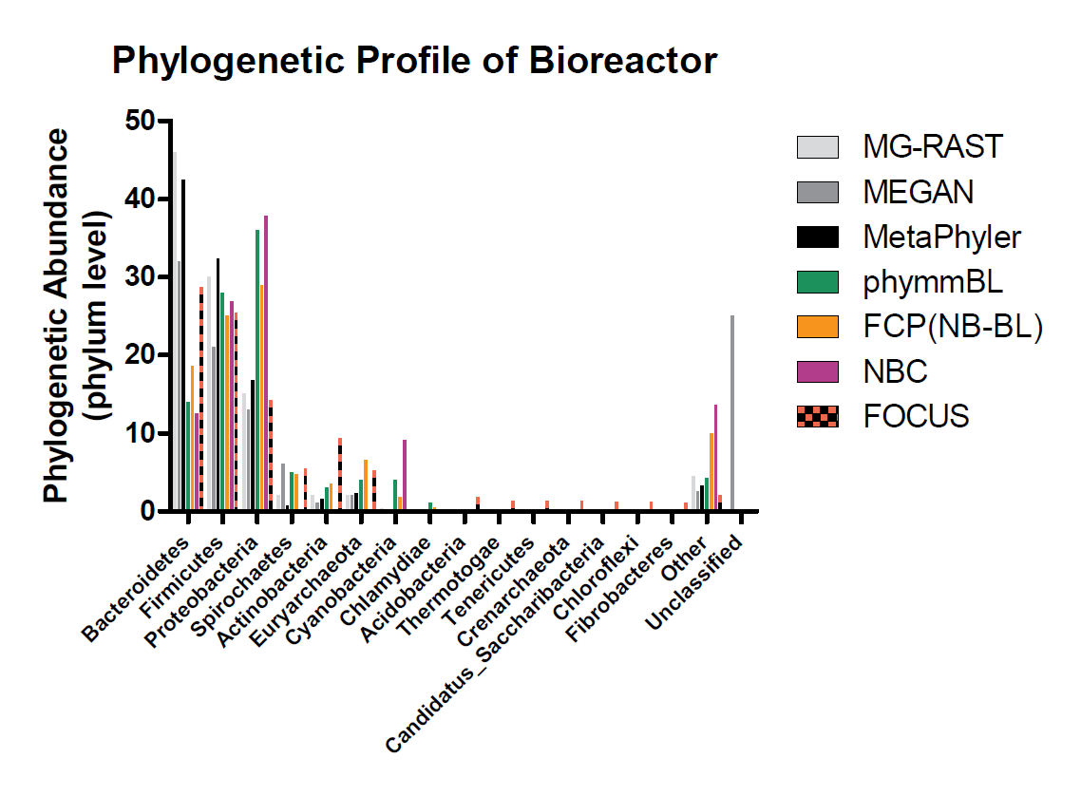
Binning of Reads in Metagenomic Datasets

Slide 21

Binning of Reads in Metagenomic Datasets

Slide 22
MEGAN at the Command Line
An Example
MEGAN http://ab.inf.uni-tuebingen.de/software/megan5/
Provides a graphical-user interface [ GUI ]
But, for repetitive tasks, take a look at the command-line interface [ CLI ]
Notes:
You’re going to be using megan, and I’ve just mentioned it, and cli…

Slide 23
MEGAN at the Command Line
MEGAN http://ab.inf.uni-tuebingen.de/software/megan5/
e.g. extract reads classified as bacteria, fungi and eukaryote for each of dozens of samples

Slide 24
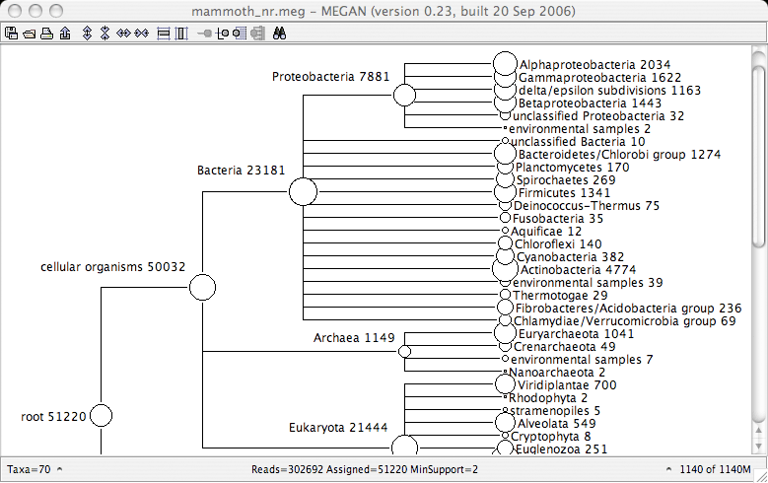
MEGAN at the Command Line
MEGAN http://ab.inf.uni-tuebingen.de/software/megan5/
e.g. extract reads classified as bacteria, fungi and eukaryote for each of dozens of samples

Slide 25
MEGAN at the Command Line
MEGAN http://ab.inf.uni-tuebingen.de/software/megan5/
e.g. extract reads classified as bacteria, fungi and eukaryote for each of dozens of samples
put all the required commands into a text file
e.g. 'extractNodesFromMegan.txt
load taxGIFile='/tgac/workarea/gi_taxid-March2015X.bin';
open file='/tgac/workarea/Projects/blastx-nr.rma';
select nodes=none;
extract what=document file='/tgac/workarea/EUK_id2759.rma' sparseFile=false
data=Taxonomy ids=2759 allBelow=true;
quit;

Slide 26
MEGAN at the Command Line
MEGAN http://ab.inf.uni-tuebingen.de/software/megan5/
e.g. extract reads classified as bacteria, fungi and eukaryote for each of dozens of samples
put all the required commands into a text file e.g. 'extractNodesFromMegan.txt‘
run without a GUI via
xvfb-run -a -e error.txt /path_to/MEGAN --commandLineMode --commandFile extractNodesFromMegan.txt
xvfb performs all graphical operations in memory without showing any screen output
Notes:
So far, focus on shotgun sequencing

Slide 27
A Basic workflow
Quality control and quality trimming of reads [cutadapt, FASTQC]
http://www.bioinformatics.babraham.ac.uk/projects/trim_galore/
Assembly [maybe…]
Binning [classification]
Similarity-based
Composition-based
Community profiling
Counts of OTUs/taxa/functions
Contingency tables
Analyse and compare samples
Relative abundance, heatmaps, ordination, statistical significance
Notes:
My focus will be on analysis, and contingency tables are the leaping off point for us here

Slide 28
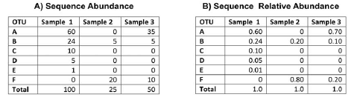
Contingency Tables
Bin the reads, produce a set of histograms
Abundances [counts]
Relative abundances
Presence/absence
Sites or Samples
Taxa, OTUs, COGs, pathways etc.

Slide 29
A Basic workflow
Quality control and quality trimming of reads [cutadapt, FASTQC]
http://www.bioinformatics.babraham.ac.uk/projects/trim_galore/
Assembly [maybe…]
Binning [classification]
Similarity-based
Composition-based
Community profiling
Counts of OTUs/taxa/functions
Contingency tables
Analyse and compare samples
Relative abundance, heatmaps, ordination, statistical significance
Notes:
My focus will be on analysis, and contingency tables are the leaping off point for us here
Once we have the tables, we can do….

Slide 30
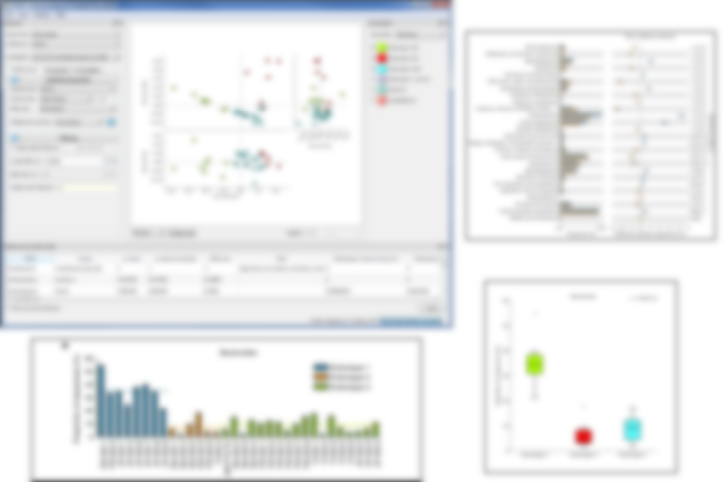
STAMP
Statistical Analysis of taxonomic and functional profiles
Infer the biological relevance of features in a metagenomic profile [taxonomic or functional]
Open source [free], linux, Mac & Windows
Handles hierarchical data
Easy exploration of statistical results
http://kiwi.cs.dal.ca/Software/STAMP

Slide 31
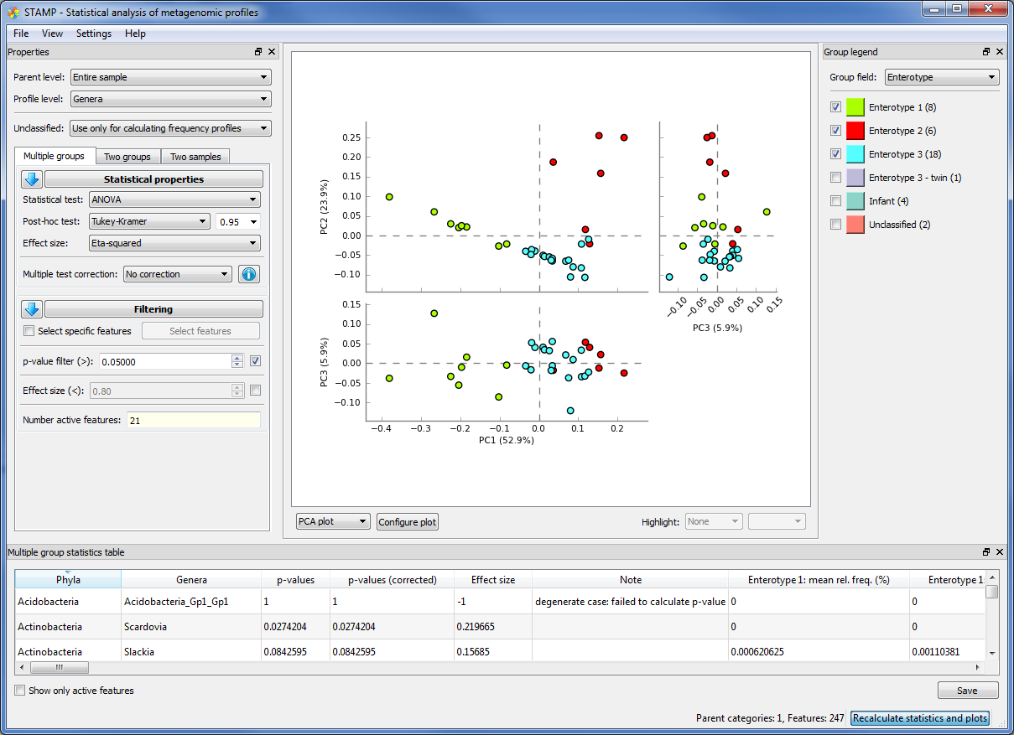
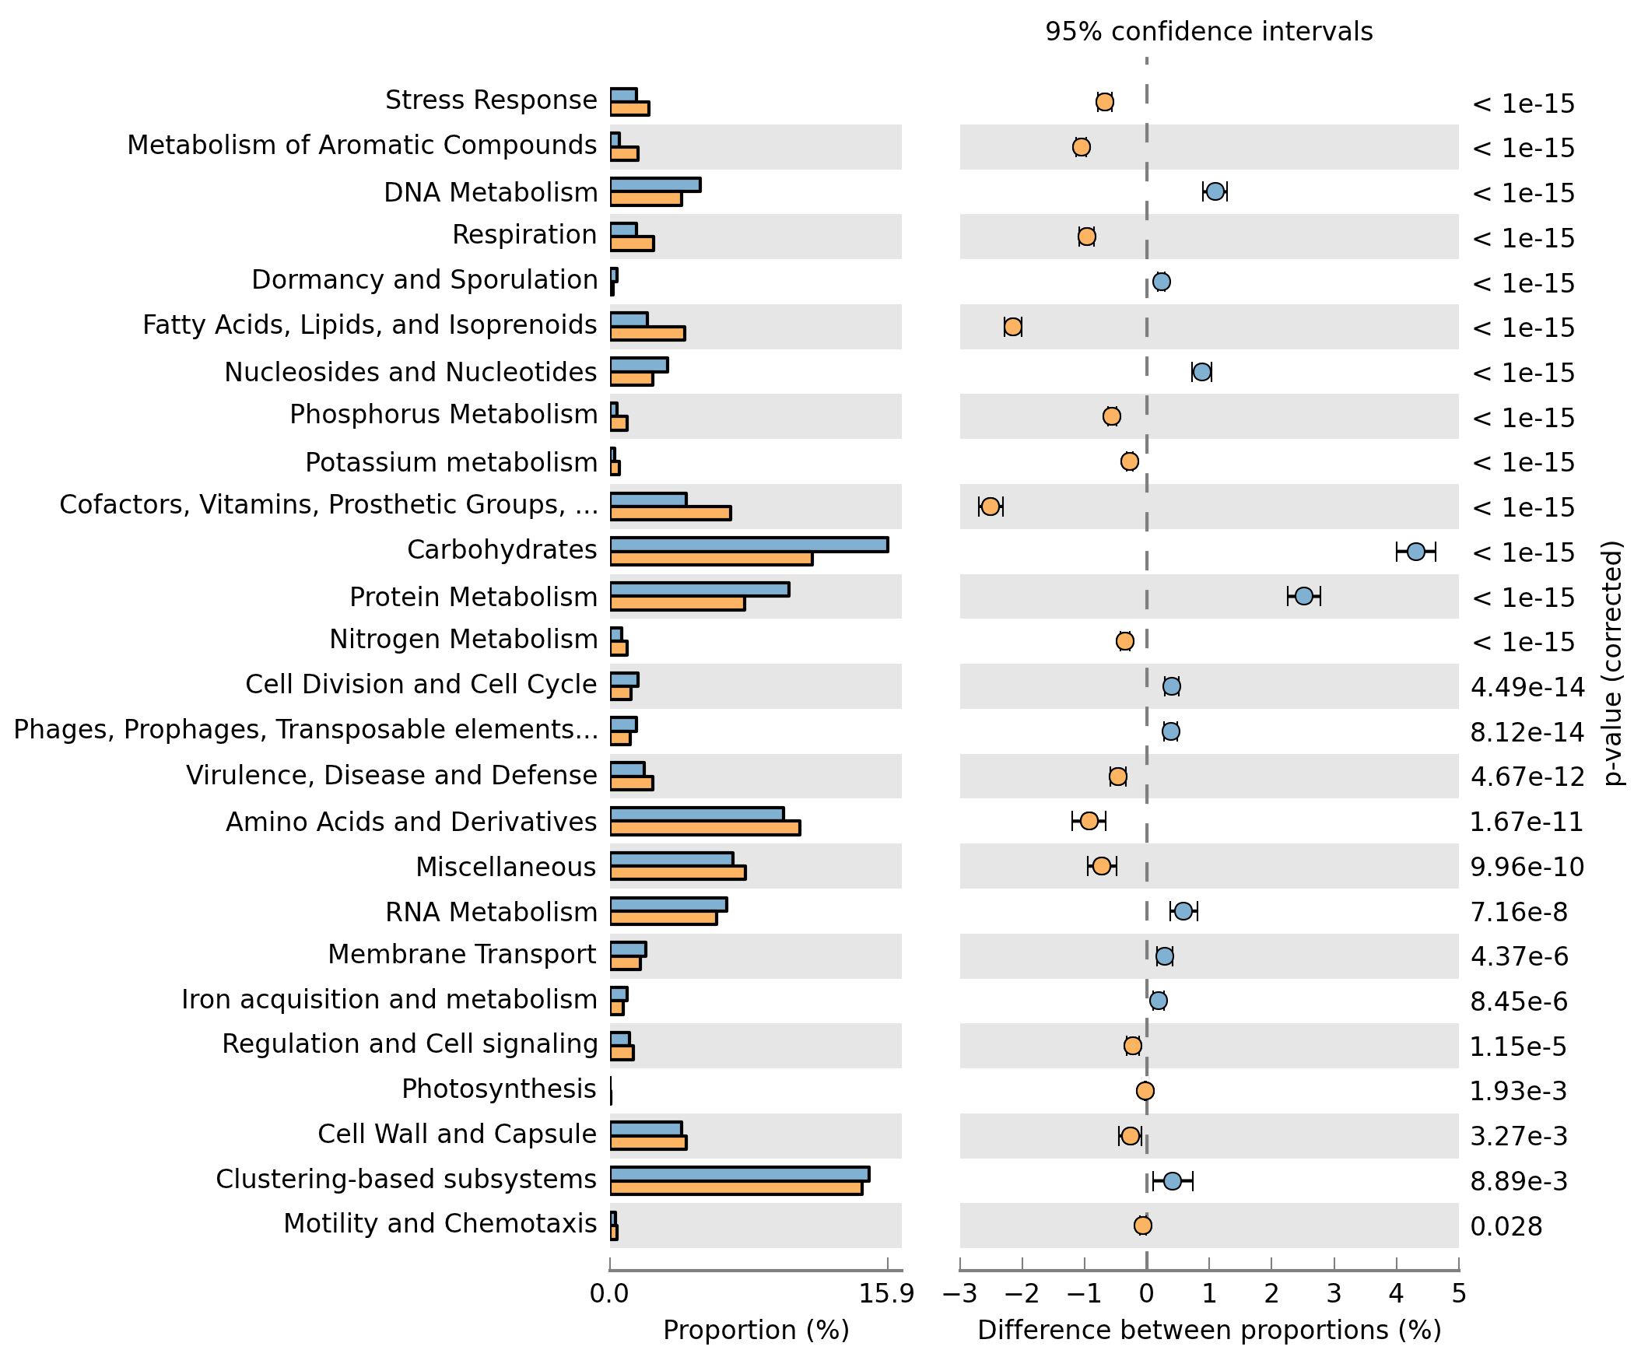
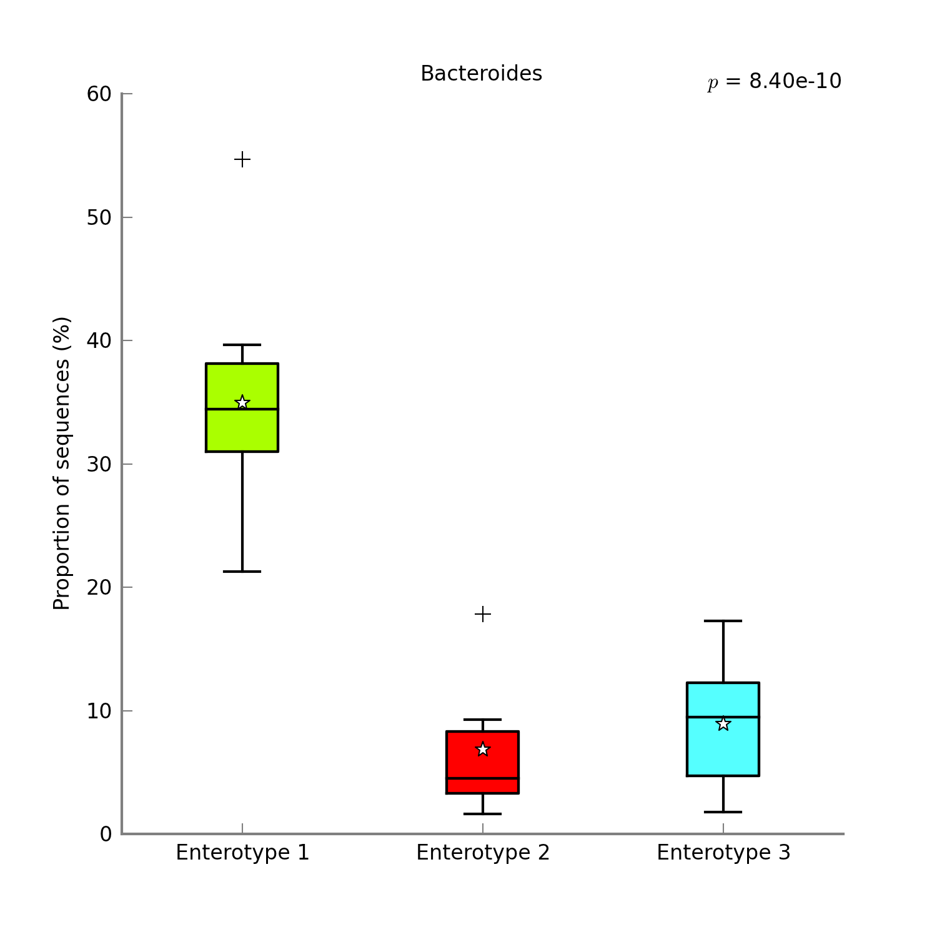
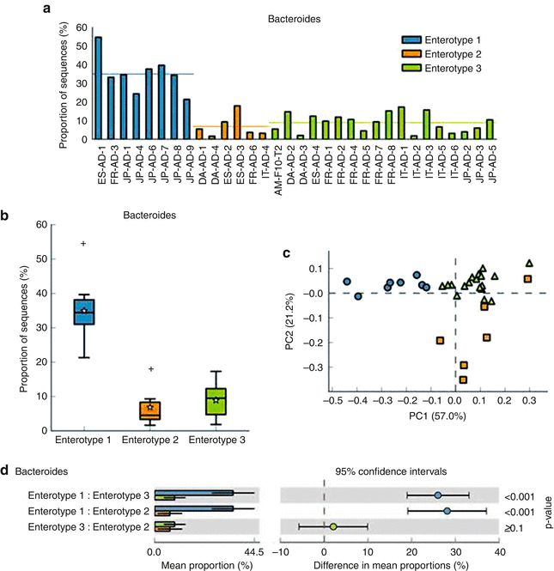
STAMP – screenshots
http://kiwi.cs.dal.ca/Software/STAMP

Slide 32
Ordination Methods
Ordination methods simplify multivariate data into low dimensional graphics
Analyses can be performed in:
Qiime, MG-RAST etc.
R statistical software using phyloseq, vegan, labdsv & ade4 packages
Notes:
OK – you’ve picked a method and got your tables

Slide 33
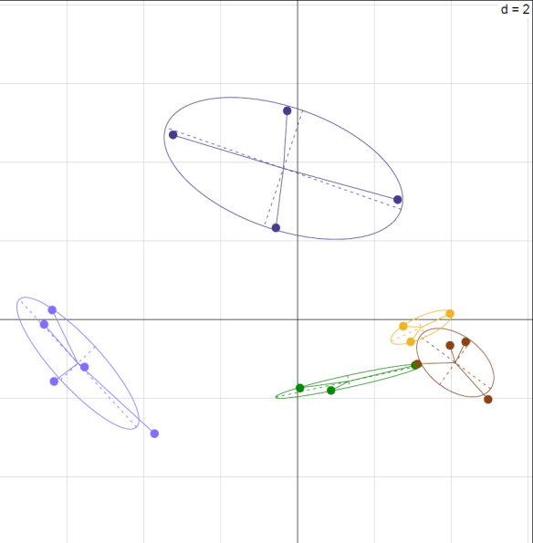
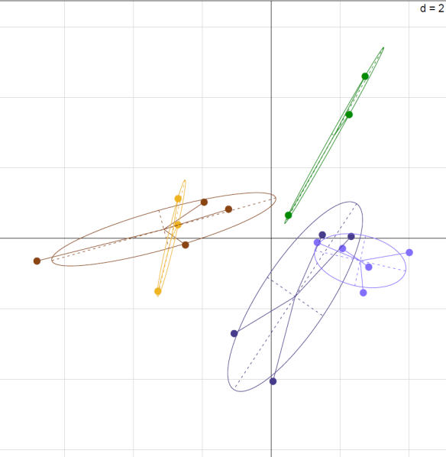
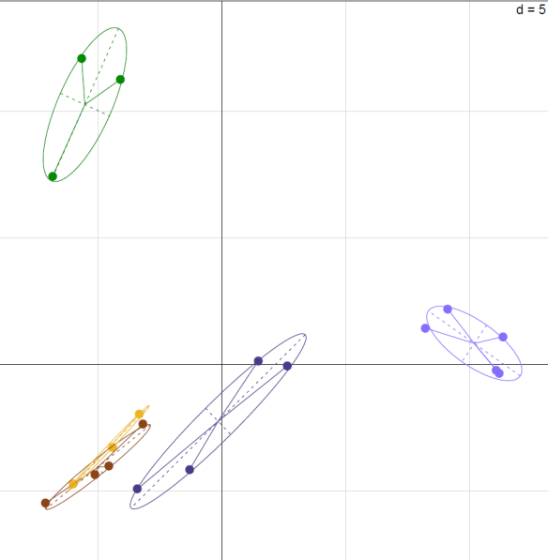
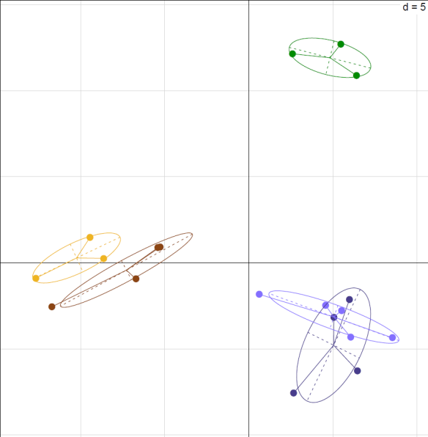
Rhizosphere Meta*omics
Eukaryotes
Prokaryotes
WT vs. sad1 oat rhizospheres
compared community structure between a wild-type oat plant (WT) and a mutant (M) deficient in [antifungal] avenacin prodn.
Eukaryote community structure was profoundly changed
WT
Phylum
M
WT
M
Genus
M
M
WT
WT
Notes:
Avenacins bind to sterols forming a pore that disrupts the cell membrane

Slide 34
Metagenomics in a Nutshell
Broad overview of bioinformatic methods for functional metagenomics
Morgan XC, Huttenhower C (2012)
PLoS Comput Biol 8(12): e1002808.

Slide 35
So far…
Broad overview of bioinformatic methods for functional metagenomics
Morgan XC, Huttenhower C (2012)
PLoS Comput Biol 8(12): e1002808.

Slide 36
Next…
Broad overview of bioinformatic methods for functional metagenomics
Morgan XC, Huttenhower C (2012)
PLoS Comput Biol 8(12): e1002808.

Slide 37
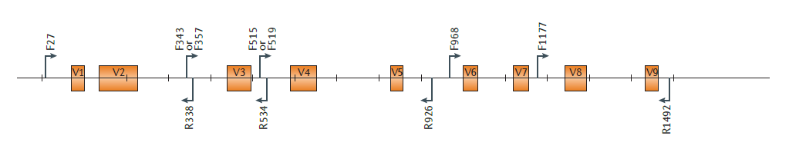
16S rRNA Data
rRNA is an excellent marker gene
Found in all species
Good 16S rRNA reference databases exist for prokaryotes
Greengenes http://greengenes.secondgenome.com/
SILVA http://www.arb-silva.de/
Amplicon [amplified fragments] analysis of raw sequences
Nature Reviews Genetics 13, 47-58

Slide 38
16S rRNA Data - Qiime [pronounced ‘chime’]
QIIME - Quantitative Insights Into Microbial Ecology http://qiime.org
Open-source bioinformatics pipeline
Raw reads, identify rRNA, cluster to OTUs, taxon classification, diversity analysis, comparative statistics, various plots

Slide 39
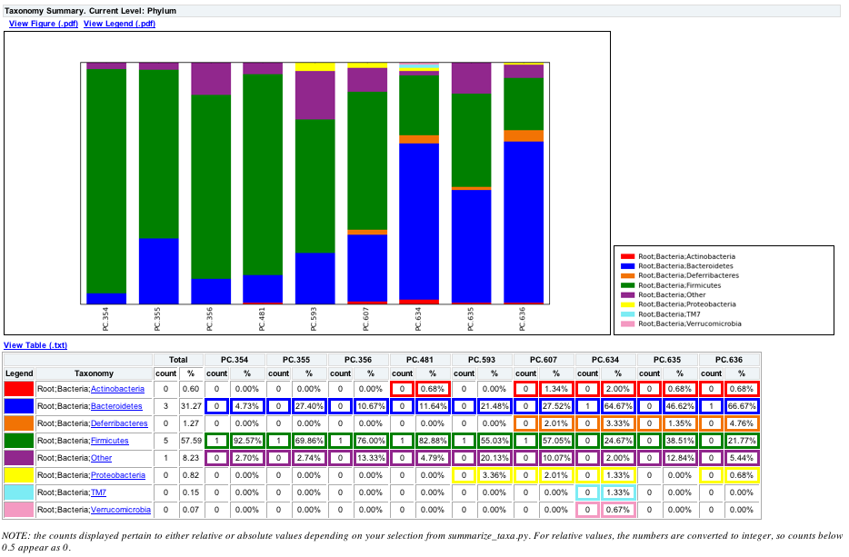
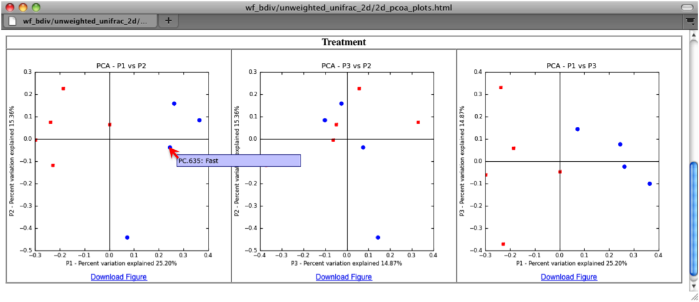
16S rRNA Data - Qiime [pronounced ‘chime’]
QIIME - Quantitative Insights Into Microbial Ecology http://qiime.org
Open-source bioinformatics pipeline
Raw reads, identify rRNA, cluster to OTUs, taxon classification, diversity analysis, comparative statistics, various plots
but they’re not that great…

Slide 40
The BIOM file output
BIOM file output [analysis with other tools]
The Biological Observation Matrix Format http://biom-format.org/
A standard representation of the “sample by observation contingency table”
Can include [hierarchical] taxonomic, metadata and phylogenetic tree information
BIOM-formatted files tab-separated text
Other software can output/read .biom files
e.g. MEGAN, STAMP, MG-RAST, Phyloseq etc.

Slide 41
16S rRNA Data - Qiime [pronounced ‘chime’]
BIOM file output [analysis with other tools]
Very active and helpful forum https://groups.google.com/forum/#!forum/qiime-forum
Excellent tutorials

Slide 42
16S rRNA Data - Qiime [pronounced ‘chime’]
BIOM file output [analysis with other tools]
Very active and helpful forum https://groups.google.com/forum/#!forum/qiime-forum
Excellent tutorials
But,
Installation is hard; use the QIIME Virtual Box
Python scripts run on CLI, e.g.
pick_open_reference_otus.py -i seqs.fna -r refseqs.fna –o outputDir

Slide 43
16S rRNA Data - Qiime [pronounced ‘chime’]
BIOM file output [analysis with other tools]
Very active and helpful forum https://groups.google.com/forum/#!forum/qiime-forum
Excellent tutorials
As an alternative: Mothur http://www.mothur.org/
CLI
A Java GUI version now available
Analyse data outside of application

Slide 44
Metagenomics in a Nutshell
Broad overview of bioinformatic methods for functional metagenomics
Morgan XC, Huttenhower C (2012)
PLoS Comput Biol 8(12): e1002808.

Slide 45
Metagenomics in a Nutshell
Broad overview of bioinformatic methods for functional metagenomics
Morgan XC, Huttenhower C (2012)
PLoS Comput Biol 8(12): e1002808.

Slide 46
Microbial Functional Pathway Analysis
MEGAN
COG, KEGG, SEED
HUMAnN software [HMP Unified Metabolic Analysis Network]
uses translated BLAST-vs-KEGG as input
collapses hits into gene families/pathways
converts to tables of KEGG pathway coverage and abundance
tables summarize the gene families and pathways in a microbial community
LEfSe [LDA Effect Size] software
visualise HUMAnN output
outputs differential features [‘biomarkers’]
Notes:
KEGG: Kyoto Encyclopedia of Genes and Genomes
* KEGG pathways: an overall picture of the molecular interaction and reaction network often combining experimental evidence from multiple organisms
* KEGG modules: a tighter functional unit of molecules generally corresponding to conserved sub-pathway in the KEGG pathway map
* Dig back from pathways [ko number] and modules [M number] to orthologous genes [K numbers]. Pathways and modules are a combination of K numbers

Slide 47
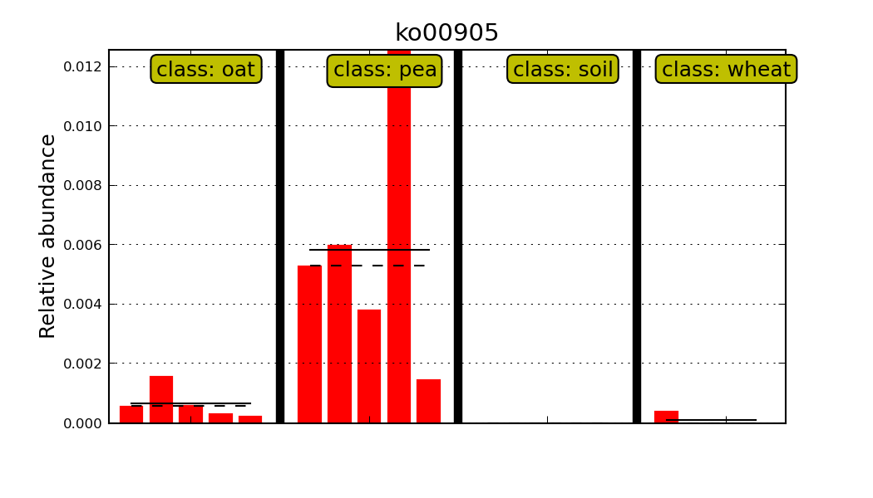
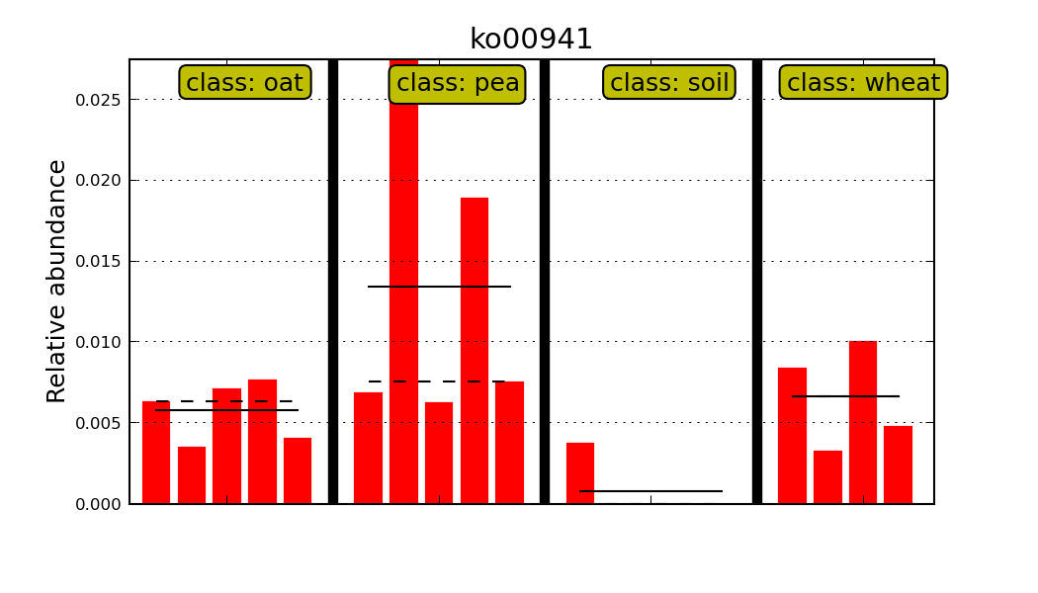
HUMAnN/LEfSe: Euk; Viridiplantae
Metabolism of terpenoids and polyketides
Brassinosteroid biosynthesis, ko00905
Brassinosteroids are plant steroid hormones regulating [root] growth and development.
Biosynthesis of other secondary metabolites
Flavonoid biosynthesis, PATH:ko00941
Chemical messengers mediating the interaction between plants and e.g. Rhizobia
Pathways give an overall picture of the reaction network
Notes:
Rhizobia are legume root-nodule bacteria. They are soil bacteria that induce the formation of special structures (nodules) on the roots of their host plants. Inside these nodules, the rhizobia fix nitrogen

Slide 48
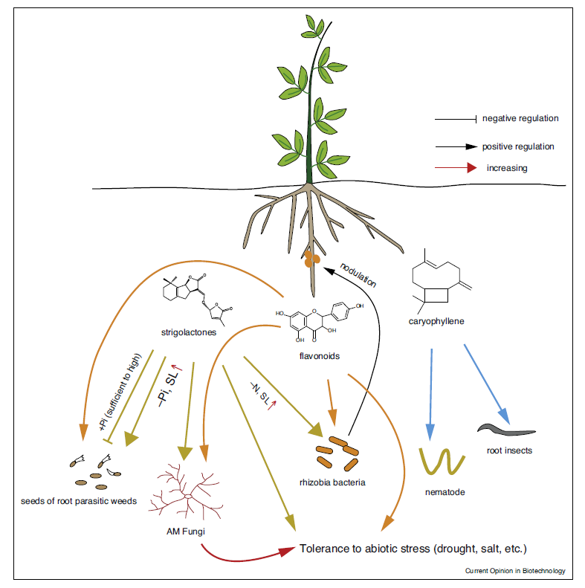
From ‘ Engineering the plant rhizosphere’
Current Opinion in Biotech. 2015, 32:136–142
Rhizobia are legume root-nodule bacteria
Induce nodule formation on roots
Inside nodules, Rhizobia fix nitrogen
Notes:
* First line of defence – plant generates anti-microbial secondary metabolites OR ‘good’ soil microbes outcompete pathogens
* High C in rhizo stimulates denitrification. Nitrogen nutrition: Plants cause, and benefit from, altered microbial N transformation

Slide 49
Other Huttenhower Software Tools
https://huttenhower.sph.harvard.edu/
HUMANaN, LEfSe etc.
Focus is on the Human Microbiome Project
Tutorials wiki https://bitbucket.org/biobakery/biobakery/wiki/Home
Galaxy server https://huttenhower.sph.harvard.edu/galaxy
bioBakery https://bitbucket.org/biobakery/biobakery/wiki/biobakery_wiki
“an easy to use, virtual environment that provides a platform for the research community to use the Huttenhower tools without having to install on their personal machines”

Slide 50
Data Analysis
Why are pirates called pirates?

Slide 51
Data Analysis
Why are pirates called pirates?
Because they ‘R’

Slide 52
Data Analysis
Why are pirates called pirates?
Because they ‘R’
And you should too! https://www.r-project.org/
Notes:
Embrace statistics!! It is your friend

Slide 53
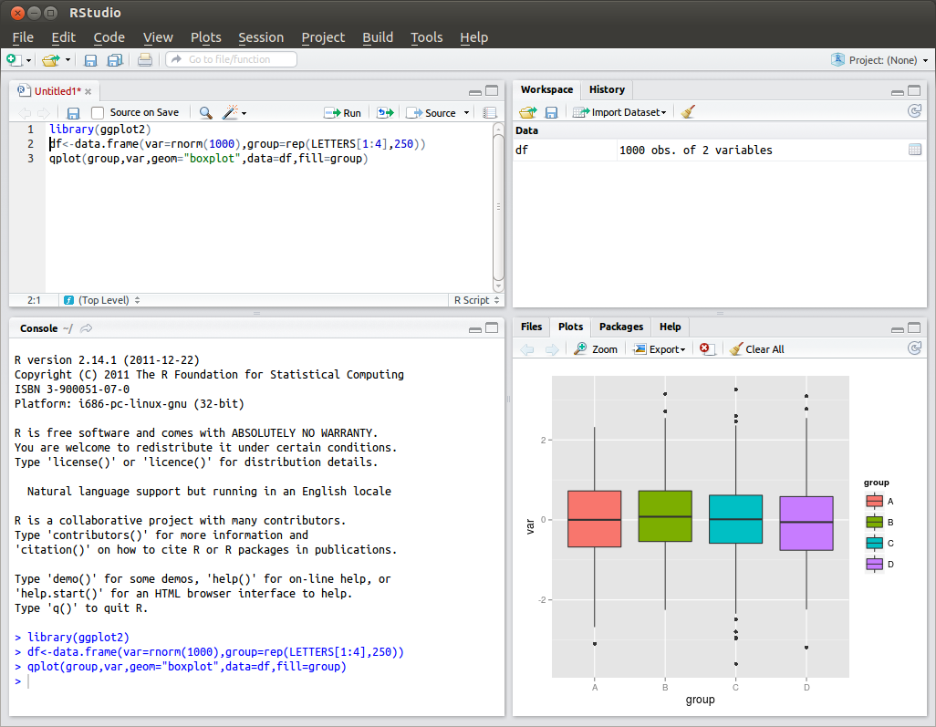
RStudio - screenshot

Slide 54
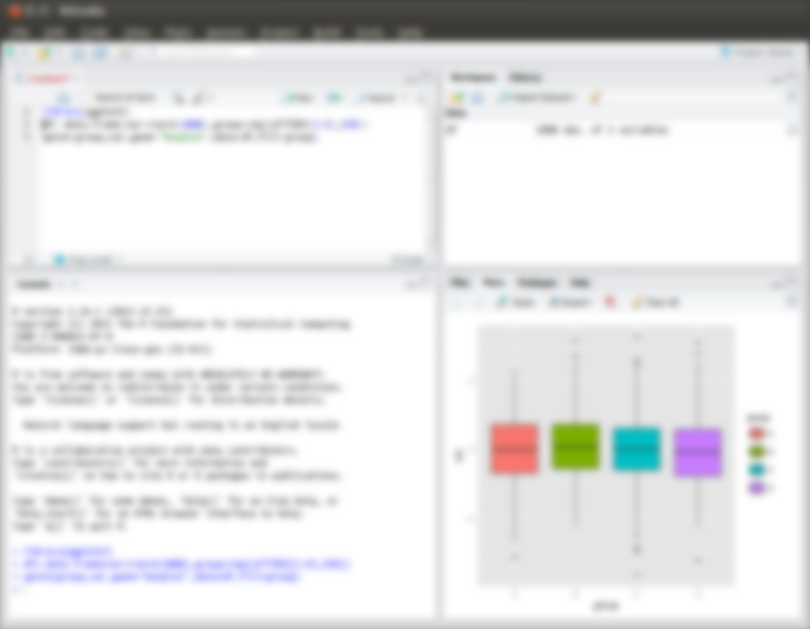
RStudio - screenshot
Install R; then check out RStudio
Integrated development environment [IDE] for R
Open source edition [free], linux, Mac & Windows
Desktop version to run locally at: https://www.rstudio.com/products/RStudio/#Desktop

Slide 55
RStudio
Install R; then check out RStudio
Integrated development environment [IDE] for R
Open source edition [free], linux, Mac & Windows
Desktop version to run locally at: https://www.rstudio.com/products/RStudio/#Desktop
Windows only: installr upgrades to the latest R version along with your installed packages http://www.r-statistics.com/tag/installr/ https://cran.r-project.org/web/packages/installr/

Slide 56
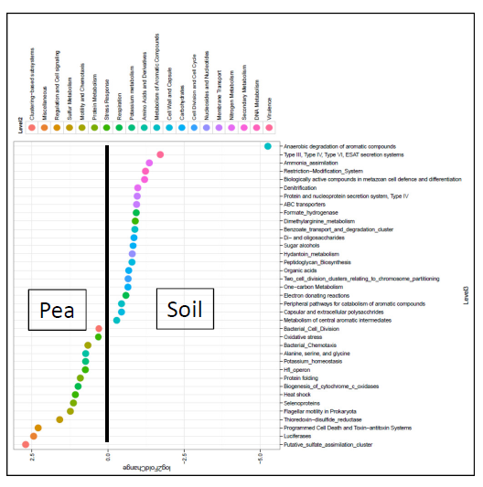
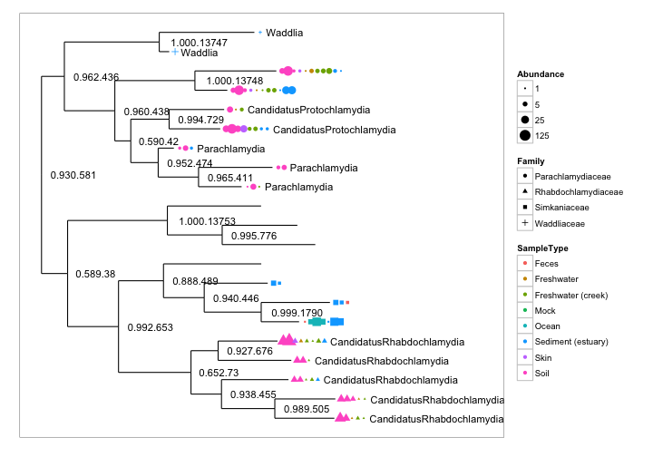
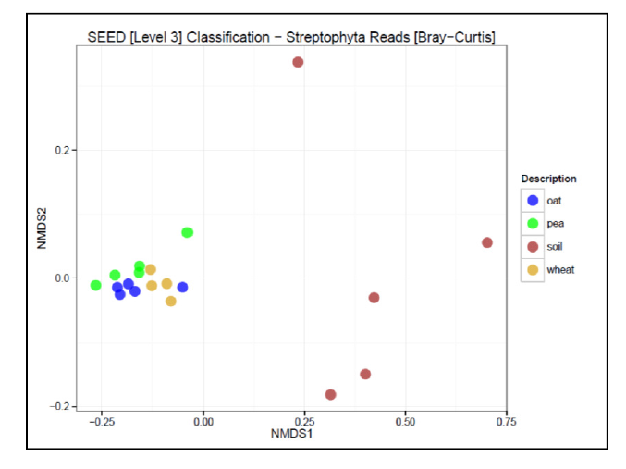
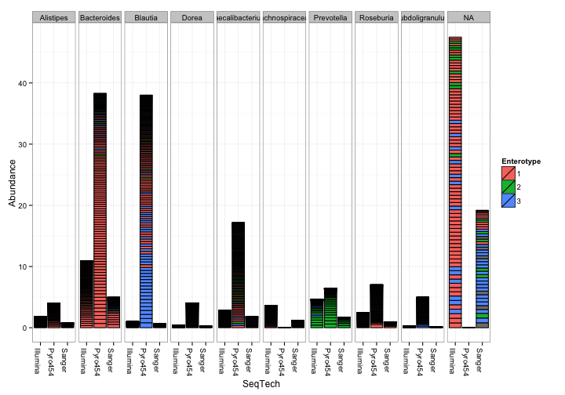
R Packages for Meta*omics
Phyloseq visualization & analysis of microbiome data
http://bioconductor.org/packages/release/bioc/html/phyloseq.html
http://joey711.github.io/phyloseq/
Notes:
Phyloseq – biom format files

Slide 57
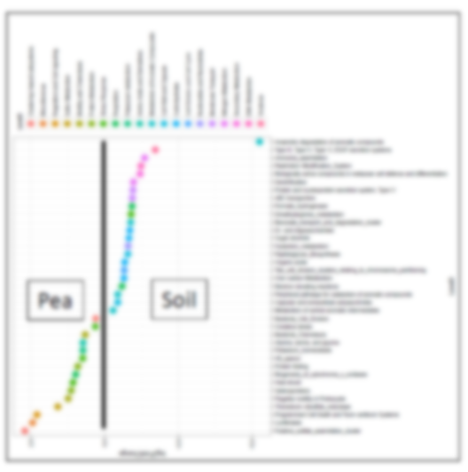
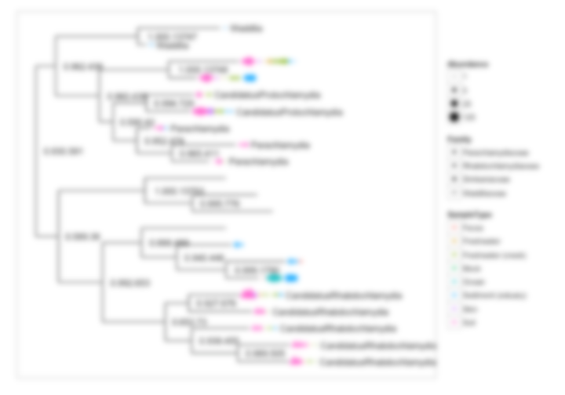
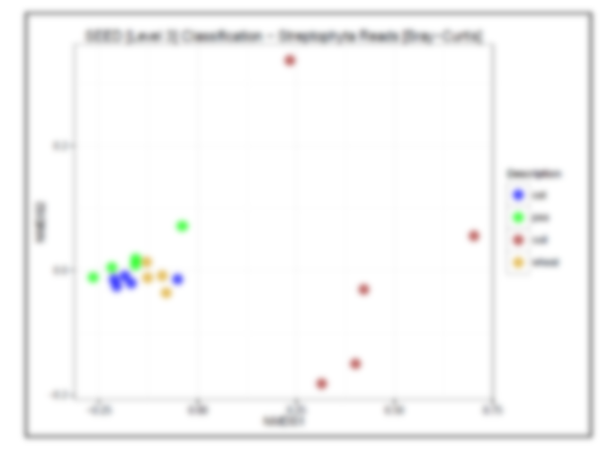
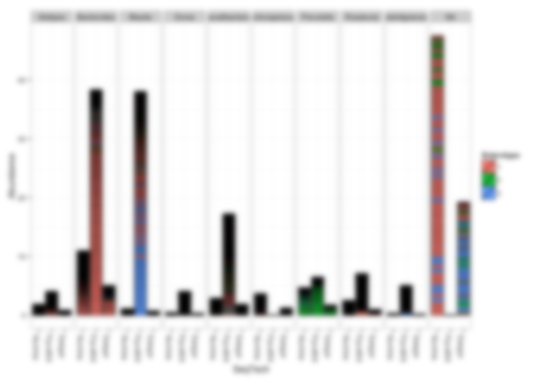
R Packages for Meta*omics
Phyloseq visualization & analysis of microbiome data
http://bioconductor.org/packages/release/bioc/html/phyloseq.html
http://joey711.github.io/phyloseq/
Vegan ordination methods & diversity analysis
https://cran.r-project.org/web/packages/vegan/index.html
DESeq2 detection of differentially expressed genes [or differentially abundant species/functions]
http://bioconductor.org/packages/release/bioc/html/DESeq2.html
Notes:
Phyloseq – biom format files

Slide 58
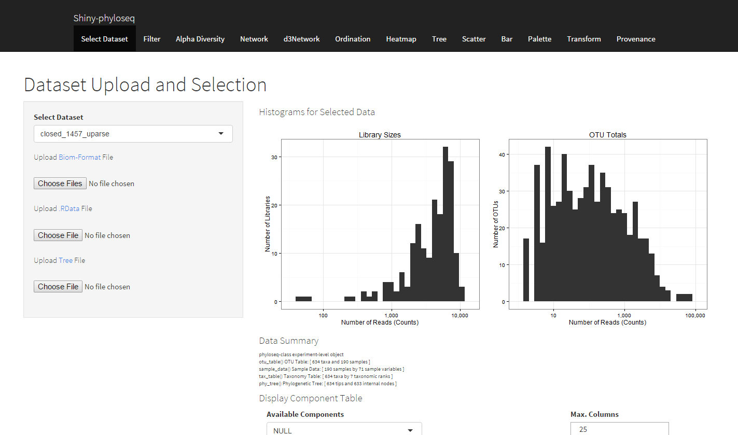
R Packages for Meta*omics
Shiny-phyloseq interactive web application providing a GUI
http://joey711.github.io/shiny-phyloseq/
Browser window front-end for Phyloseq
Invoke from the R command line
Notes:
Phyloseq – biom format files

Slide 59
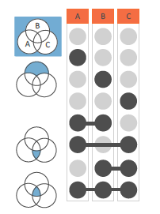
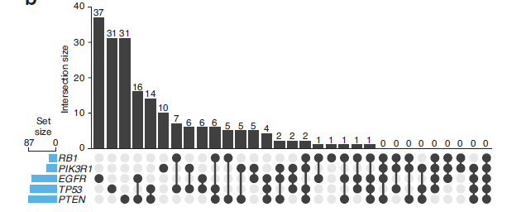
R Packages for Meta*omics
UpSetR
visualization of intersecting sets
http://vcg.github.io/upset/about/#
https://cran.r-project.org/web/packages/UpSetR/

Slide 60
Getting help

Slide 61
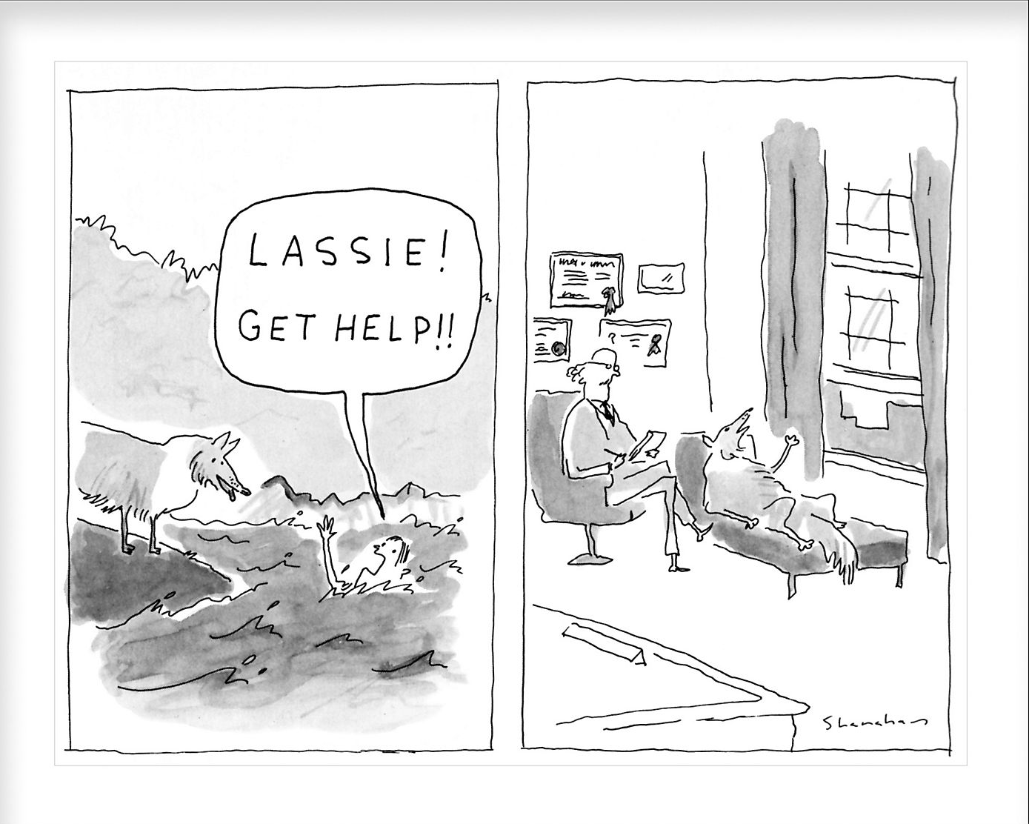
Getting help
the right sort of

Slide 62
More Training [!] and Finding Answers
Biostars ‘bioinformatics explained’ https://www.biostars.org/
SEQanswers ‘the NGS community’ http://seqanswers.com/
GOBLET ‘a global repository of bioinformatics training materials, courses and trainers’ http://mygoblet.org/ http://mygoblet.org/training-portal

Slide 63
Data Analysis and Interpretation
Nature Web Collection ‘Statistics for Biologists’ http://www.nature.com/collections/qghhqm
“Points of Significance”
basic introduction to core statistical concepts and methods, including experimental design
Data visualization
http://blogs.nature.com/methagora/2013/07/data-visualization-points-of-view.html

Slide 64
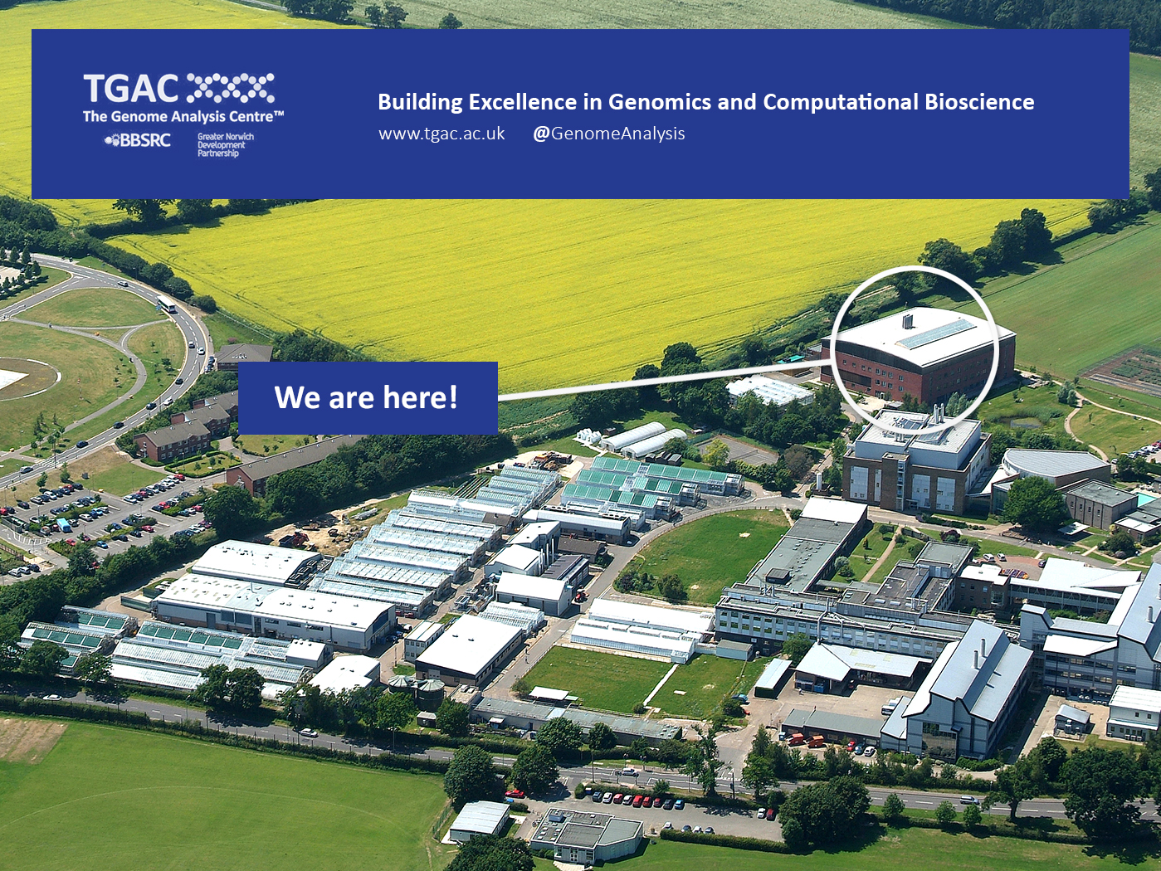

Biotechnology and Biological Sciences Research Council
Notes:
TGAC one of several institutes at the Norwich Research Park

Slide 65
The 3 BBSRC Strategic Research Priorities
Agriculture and Food Security
Industrial Biotechnology and Bioenergy
Bioscience for Health
Notes:
The 3 BBSRC Strategic research priorities

Slide 66
The 3 BBSRC Strategic Research Priorities
Agriculture and Food Security
Industrial Biotechnology and Bioenergy
Bioscience for Health
Areas of Application for meta*omics
Notes:
The 3 BBSRC Strategic research priorities
Meta*omics lends itself to the study

Slide 67
Meta*omic Projects at TGAC
Agriculture and Food Security
rhizosphere microbiota (soil and crops)
Industrial Biotechnology and Bioenergy
biogas (methane bioreactors)
Bioscience for Health
Host-pathogen mouse-gut disease model (citrobacter)
metagenomic study of viruses in fruit bats
characterise bacterial populations in cystic fibrosis
probiotics & gut microbiota composition in neonates
Notes:
Projects a mixture of 16S and WSG

Slide 68
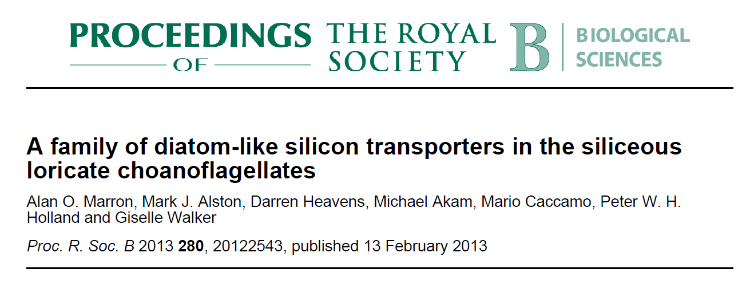
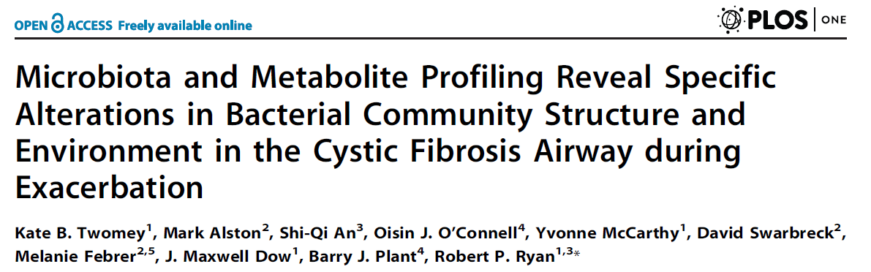
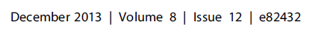
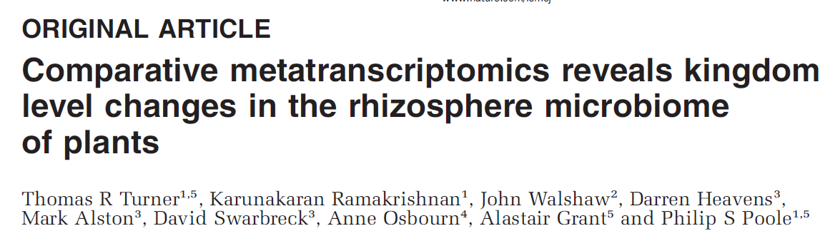
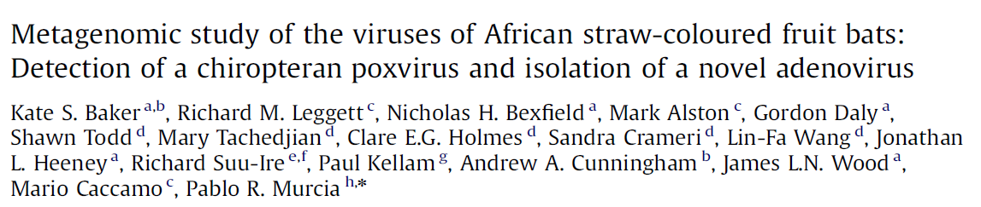
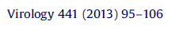
Meta*omic TGAC Publications
The ISME Journal 7, 2248-2258 (December 2013)

Slide 69
Finally [!]
Areas of application for meta*omics are crucial, high- impact areas of research [health, food-security etc.]
meta*omics [immature] resulted from NGS [mature]
An active area and rapidly evolving
A challenge to keep ‘up-to-date’
Sometimes frustrating but never boring!

Slide 70

mark.alston@tgac.ac.uk

